Slide 1

Chapter 1 Introduction
A note on the use of these PowerPoint slides:
We’re making these slides freely available to all (faculty, students, readers). They’re in PowerPoint form so you see the animations; and can add, modify, and delete slides (including this one) and slide content to suit your needs. They obviously represent a lot of work on our part. In return for use, we only ask the following:
If you use these slides (e.g., in a class) that you mention their source (after all, we’d like people to use our book!)
If you post any slides on a www site, that you note that they are adapted from (or perhaps identical to) our slides, and note our copyright of this material.
For a revision history, see the slide note for this page.
Thanks and enjoy! JFK/KWR
All material copyright 1996-2023
J.F Kurose and K.W. Ross, All Rights Reserved
Computer Networking: A Top-Down Approach 8th edition Jim Kurose, Keith Ross Pearson, 2020
Notes:
(8.2)Version History
7.2 (January 2020)
All slides reformatted for 16:9 aspect ratio
Use of Calibri font, rather that Gill Sans MT
Updated slide content for 2020 link technologies and applications
Add more animation throughout
New Master slide
Feb. 2020 (8.0)
a few updates suggest by Catherine Rosenberg (thanks!)
titles in a lighter font
Sept 2020 (8.1)
Added ~7 new slides, in particular: data center slide; routing versus forwarding; security line of defense; several on encapsulation and layers (this section is a lot better now). Other relative minor changes throughout
Feb. 2023 (8.2)
few minor updates (mostly speeds, technology details)

Slide 2

Chapter 1: introduction
Chapter goal:
Get “feel,” “big picture,” introduction to terminology
more depth, detail later in course
Overview/roadmap:
What is the Internet? What is a protocol?
Network edge: hosts, access network, physical media
Network core: packet/circuit switching, internet structure
Performance: loss, delay, throughput
Protocol layers, service models
Security
History
Notes:
Circuit switching is a communication method where a dedicated communication path, or circuit, is established between two devices before data transmission begins.
Packet switching is a communication method where data is divided into smaller units called packets and transmitted over the network.

Slide 3
















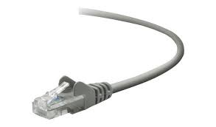
The Internet: a “nuts and bolts” view
Billions of connected computing devices:
hosts = end systems
running network apps at Internet’s “edge”
mobile network
national or global ISP
Packet switches: forward packets (chunks of data)
routers, switches
local or regional ISP
Internet
Communication links
fiber, copper, radio, satellite
transmission rate: bandwidth
home network
content
provider
network
datacenter
network
Networks
collection of devices, routers, links: managed by an organization
enterprise
network

Slide 4
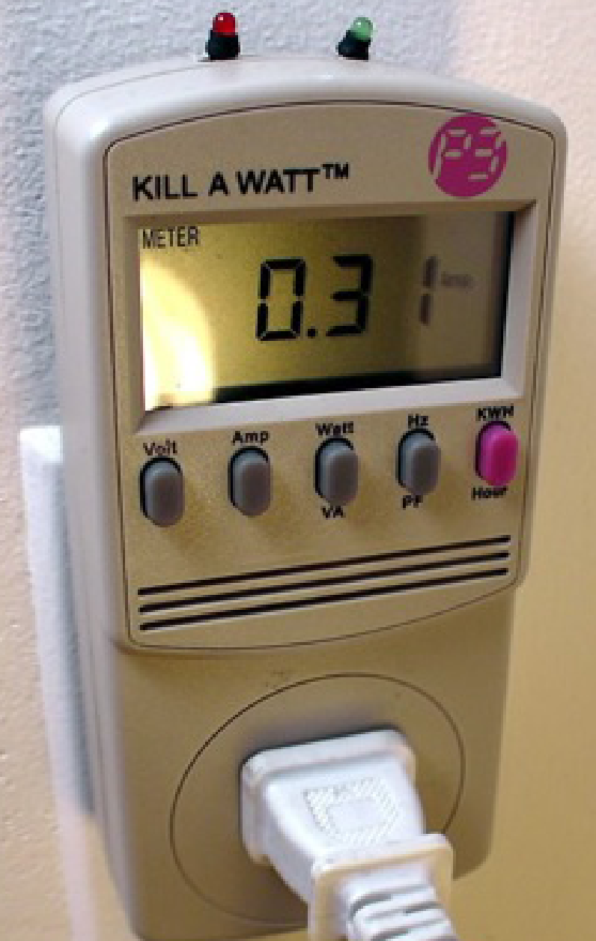


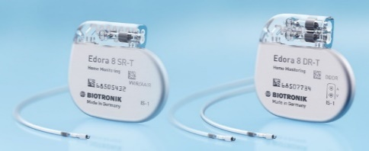




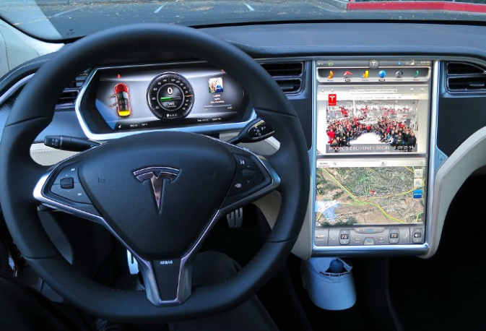



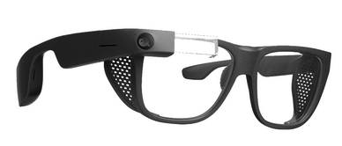
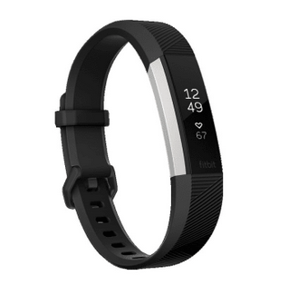

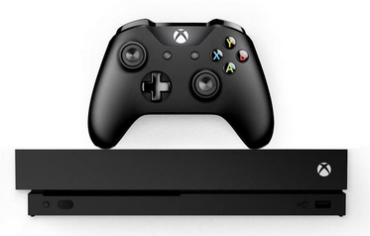

“Fun” Internet-connected devices
Tweet-a-watt:
monitor energy use
bikes
Pacemaker & Monitor
Amazon Echo
Web-enabled toaster +
weather forecaster
IP picture frame
Internet
refrigerator
Slingbox: remote
control cable TV
cars
Security Camera
AR devices
sensorized,
bed
mattress
scooters
Fitbit
Others?
Gaming devices
Internet phones

Slide 5
The Internet: a “nuts and bolts” view
mobile network
4G
Internet: “network of networks”
Interconnected ISPs
national or global ISP
protocols are everywhere
control sending, receiving of messages
e.g., HTTP (Web), streaming video, Skype, TCP, IP, WiFi, 4/5G, Ethernet
IP
Streaming
video
Skype
local or regional ISP
home network
content
provider
network
Internet standards
RFC: Request for Comments
IETF: Internet Engineering Task Force
HTTP
datacenter
network
Ethernet
TCP
enterprise
network
WiFi

Slide 6
The Internet: a “services” view
Infrastructure that provides services to applications:
Web, streaming video, multimedia teleconferencing, email, games, e-commerce, social media, inter-connected appliances, …
mobile network
national or global ISP
Streaming
video
Skype
local or regional ISP
provides programming interface to distributed applications:
“hooks” allowing sending/receiving apps to “connect” to, use Internet transport service
provides service options, analogous to postal service
home network
content
provider
network
HTTP
datacenter
network
enterprise
network

Slide 7
What’s a protocol?
Human protocols:
“what’s the time?”
“I have a question”
introductions
Network protocols:
computers (devices) rather than humans
all communication activity in Internet governed by protocols
Rules for:
… specific messages sent
… specific actions taken when message received, or other events
Protocols define the format, order of messages sent and received among network entities, and actions taken on message transmission, receipt

Slide 8



What’s a protocol?
A human protocol and a computer network protocol:
Hi
TCP connection
request
Hi
TCP connection
response
Got the
time?
GET http://gaia.cs.umass.edu/kurose_ross
2:00
<file>
time
Q: other human protocols?
Notes:
Explain important points
distributed entities, exchanging messages (governed by protocols)
Time going down
go over definition of protocol (showing format, order of messages sent and received, and actions taken)
We’ll see these kinds of diagrams a lot

Slide 9
Chapter 1: roadmap
What is the Internet?
What is a protocol?
Network edge: hosts, access network, physical media
Network core: packet/circuit switching, internet structure
Performance: loss, delay, throughput
Security
Protocol layers, service models
History

Slide 10
A closer look at Internet structure
mobile network
Network edge:
hosts: clients and servers
servers often in data centers
national or global ISP
local or regional ISP
home network
content
provider
network
datacenter
network
enterprise
network

Slide 11
A closer look at Internet structure
mobile network
Network edge:
hosts: clients and servers
servers often in data centers
Access networks, physical media:
wired, wireless communication links
national or global ISP
local or regional ISP
home network
content
provider
network
datacenter
network
enterprise
network

Slide 12
A closer look at Internet structure
mobile network
Network edge:
hosts: clients and servers
servers often in data centers
Access networks, physical media:
wired, wireless communication links
Network core:
interconnected routers
network of networks
national or global ISP
local or regional ISP
home network
content
provider
network
datacenter
network
enterprise
network

Slide 13
Access networks and physical media
Q: How to connect end systems to edge router?
residential access nets
institutional access networks (school, company)
mobile access networks (WiFi, 4G/5G)
mobile network
national or global ISP
local or regional ISP
home network
content
provider
network
datacenter
network
enterprise
network

Slide 14
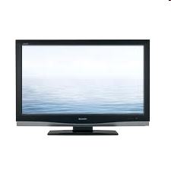


Access networks: cable-based access
cable headend
…
cable
modem
splitter
C
O
N
T
R
O
L
V
I
D
E
O
V
I
D
E
O
V
I
D
E
O
V
I
D
E
O
V
I
D
E
O
V
I
D
E
O
D
A
T
A
D
A
T
A
1
2
3
4
5
6
7
8
9
Channels
frequency division multiplexing (FDM): different channels transmitted in different frequency bands

Slide 15
Access networks: cable-based access
cable headend
…
cable
modem
splitter
CMTS
cable modem
termination system
data, TV transmitted at different
frequencies over shared cable
distribution network
ISP
HFC: hybrid fiber coax
asymmetric: up to 40 Mbps – 1.2 Gbps downstream transmission rate, 30-100 Mbps upstream transmission rate
network of cable, fiber attaches homes to ISP router
homes share access network to cable headend
Notes:
Cable modems

Slide 16

Access networks: digital subscriber line (DSL)
central office
telephone
network
DSL
modem
splitter
DSLAM
voice, data transmitted
at different frequencies over
dedicated line to central office
ISP
DSL access
multiplexer
use existing telephone line to central office DSLAM
data over DSL phone line goes to Internet
voice over DSL phone line goes to telephone net
24-52 Mbps dedicated downstream transmission rate
3.5-16 Mbps dedicated upstream transmission rate
Notes:
Digital Subscriber Line Access Multiplexer

Slide 17







Access networks: home networks
Wireless and wired
devices
to/from headend or central office
often combined
in single box
cable or DSL modem
WiFi wireless access
point (54, 450 Mbps)
router, firewall, NAT
wired Ethernet (1 Gbps)
Notes:
Network Address Translation

Slide 18








Wireless access networks
Shared wireless access network connects end system to router
via base station aka “access point”
Wide-area cellular access networks
provided by mobile, cellular network operator (10’s km)
10’s Mbps
4G/5G cellular networks
Wireless local area networks (WLANs)
typically within or around building (~100 ft)
802.11b/g/n (WiFi): 11, 54, 450 Mbps transmission rate
to Internet
to Internet
Notes:
802.11b/g/n" mentioned together, it indicates that the device or network supports multiple Wi-Fi standards and is backward compatible with older devices using 802.11b and 802.11g, while also supporting the faster speeds and improved performance of 802.11n.
b/g are frequency band while n is the capability to utilise multiple frequency bands to do multiple input multiple output.

Slide 19









Access networks: enterprise networks
Enterprise link to
ISP (Internet)
institutional router
Ethernet
switch
institutional mail,
web servers
companies, universities, etc.
mix of wired, wireless link technologies, connecting a mix of switches and routers (we’ll cover differences shortly)
Ethernet: wired access at 100Mbps, 1Gbps, 10Gbps
WiFi: wireless access points at 11, 54, 450 Mbps

Slide 20
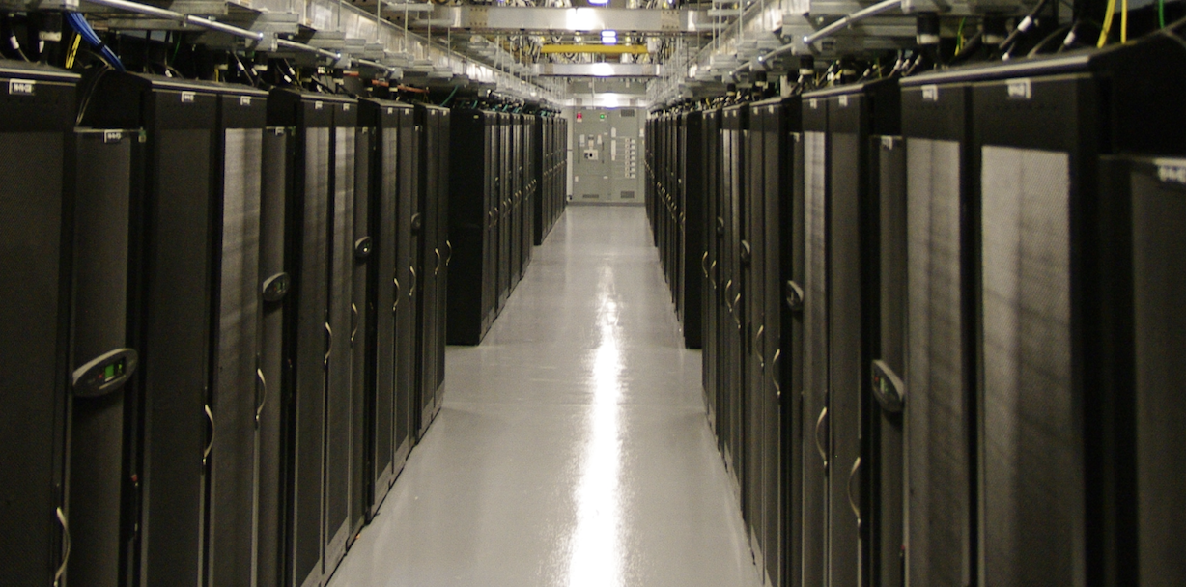
Access networks: data center networks
mobile network
high-bandwidth links (10s to 100s Gbps) connect hundreds to thousands of servers together, and to Internet
national or global ISP
local or regional ISP
home network
content
provider
network
datacenter
network
Courtesy: Massachusetts Green High Performance Computing Center (mghpcc.org)
enterprise
network

Slide 21
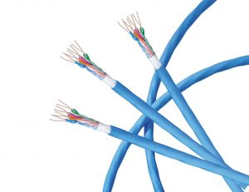
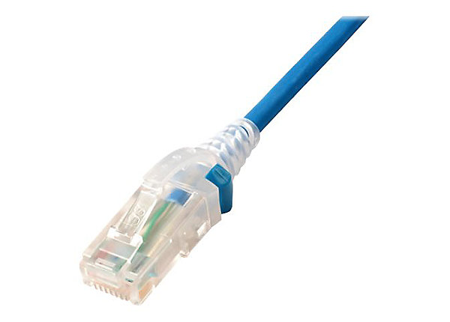
Links: physical media
bit: propagates between transmitter/receiver pairs
physical link: what lies between transmitter & receiver
guided media:
signals propagate in solid media: copper, fiber, coax
unguided media:
signals propagate freely, e.g., radio
Twisted pair (TP)
two insulated copper wires
Category 5: 100 Mbps, 1 Gbps Ethernet
Category 6: 10Gbps Ethernet

Slide 22
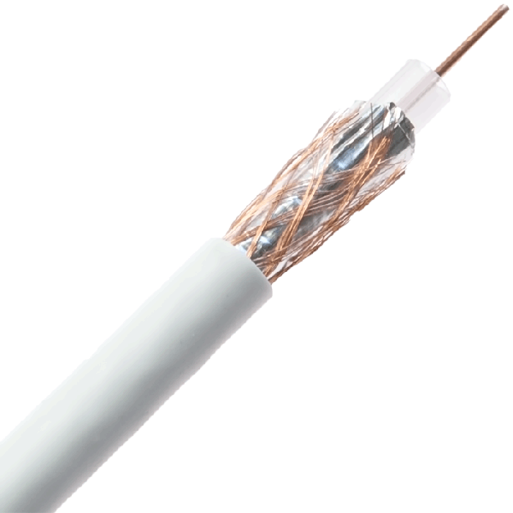
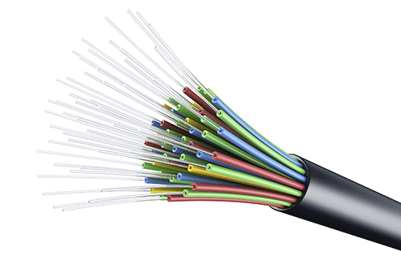
Links: physical media
Coaxial cable:
two concentric copper conductors
bidirectional
broadband:
multiple frequency channels on cable
100’s Mbps per channel
Fiber optic cable:
glass fiber carrying light pulses, each pulse a bit
high-speed operation:
high-speed point-to-point transmission (10’s-100’s Gbps)
low error rate:
repeaters spaced far apart
immune to electromagnetic noise

Slide 23
Links: physical media
Wireless radio
signal carried in various “bands” in electromagnetic spectrum
no physical “wire”
broadcast, “half-duplex” (sender to receiver)
propagation environment effects:
reflection
obstruction by objects
Interference/noise
Radio link types:
Wireless LAN (WiFi)
10-100’s Mbps; 10’s of meters
wide-area (e.g., 4G/5G cellular)
10’s Mbps (4G) over ~10 Km
Bluetooth: cable replacement
short distances, limited rates
terrestrial microwave
point-to-point; 45 Mbps channels
satellite
up to < 100 Mbps (Starlink) downlink
270 msec end-end delay (geostationary)

Slide 24
Chapter 1: roadmap
What is the Internet?
What is a protocol?
Network edge: hosts, access network, physical media
Network core: packet/circuit switching, internet structure
Performance: loss, delay, throughput
Security
Protocol layers, service models
History

Slide 25
The network core
mesh of interconnected routers
packet-switching: hosts break application-layer messages into packets
network forwards packets from one router to the next, across links on path from source to destination
mobile network
national or global ISP
local or regional ISP
home network
content
provider
network
datacenter
network
enterprise
network

Slide 26
Two key network-core functions
routing algorithm
Routing:
global action: determine source-destination paths taken by packets
routing algorithms
routing algorithm
Forwarding:
aka “switching”
local action: move arriving packets from router’s input link to appropriate router output link
local forwarding table
local forwarding table
header value
output link
0100
0101
0111
1001
3
2
2
1
1
3
2
0111
destination address in arriving
packet’s header

Slide 27
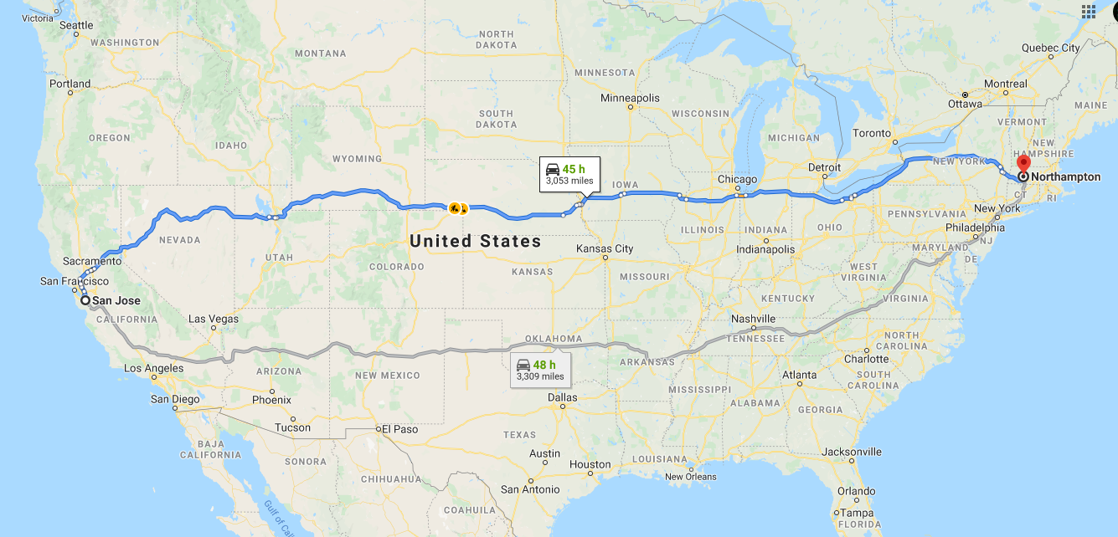
routing

Slide 28
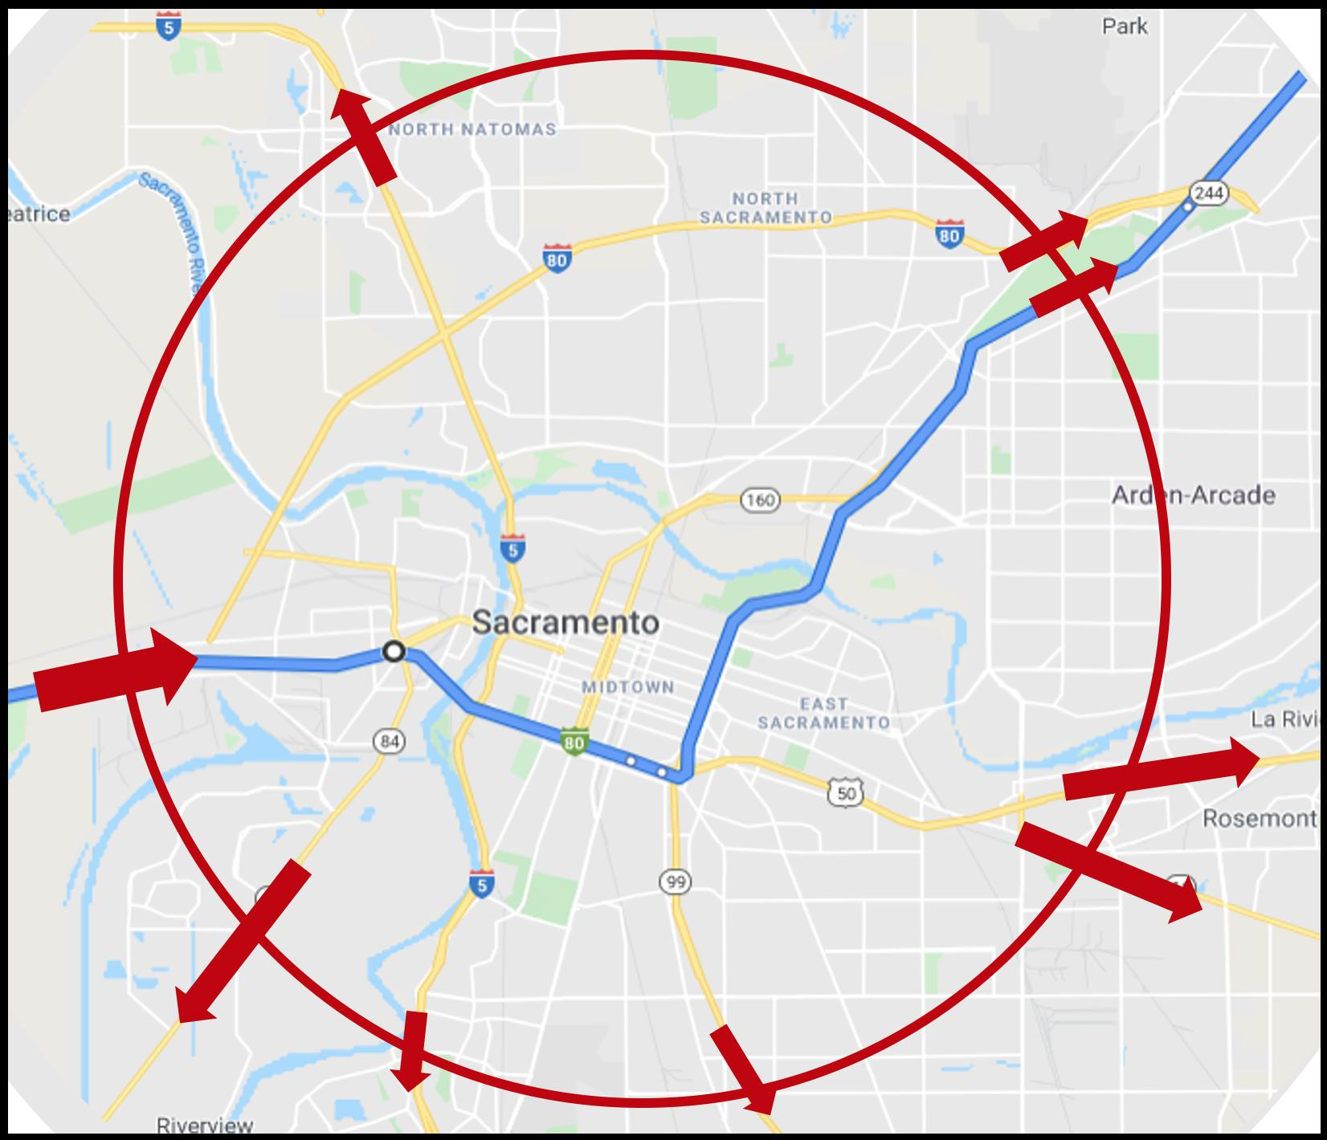
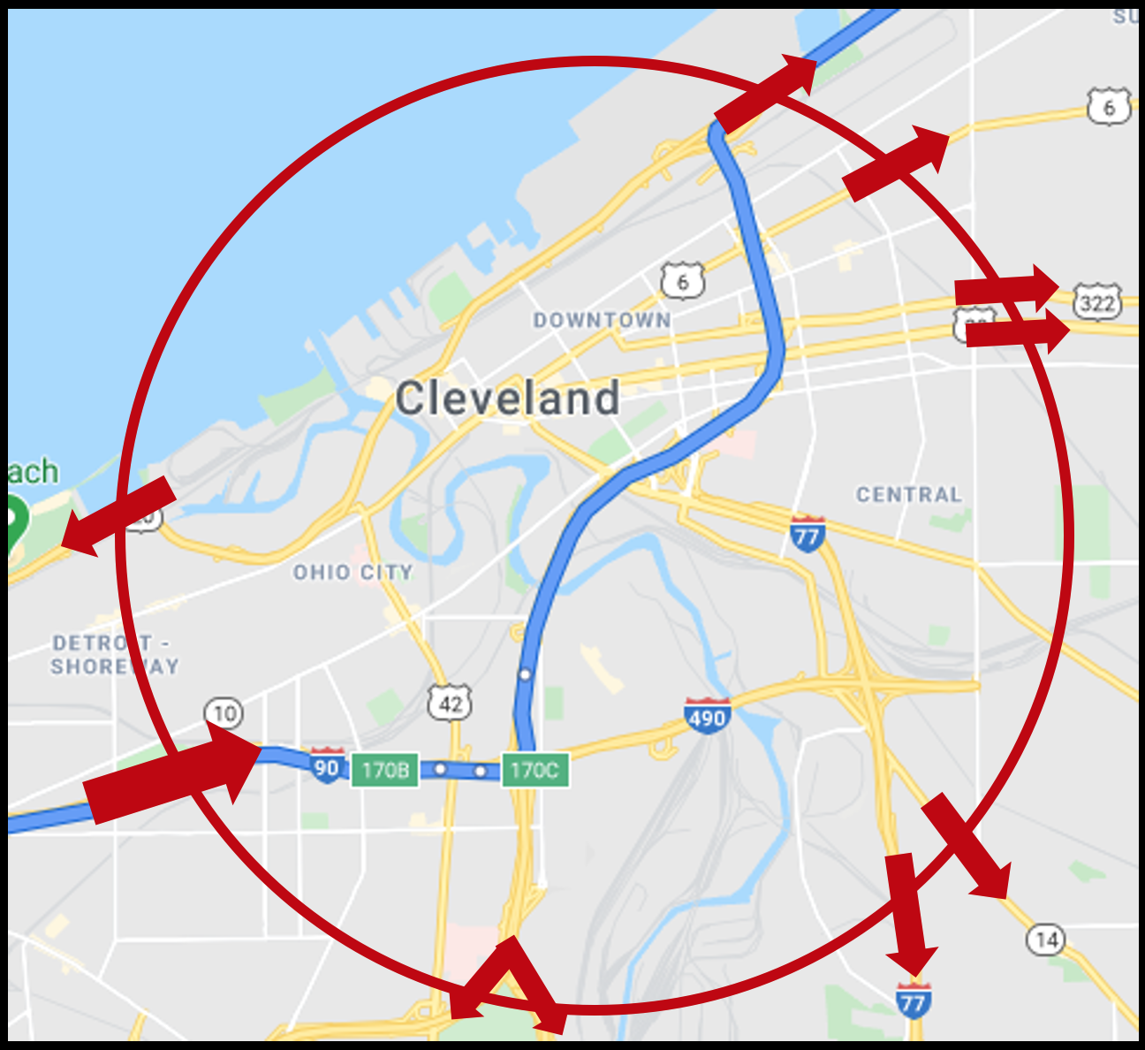
forwarding
forwarding

Slide 29


Host: sends packets of data
host sending function:
takes application message
breaks into smaller chunks, known as packets, of length L bits
transmits packet into access network at transmission rate R
link transmission rate, aka link capacity, aka link bandwidth
two packets,
L bits each
2
1
host
R: link transmission rate
packet
transmission
delay
time needed to
transmit L-bit
packet into link
L (bits)
R (bits/sec)
=
=

Slide 30



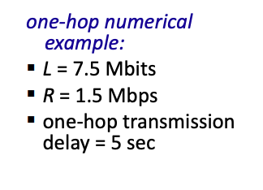
Packet-switching: store-and-forward
L bits
per packet
source
3
2
1
destination
R bps
R bps
packet transmission delay: takes L/R seconds to transmit (push out) L-bit packet into link at R bps
store and forward: entire packet must arrive at router before it can be transmitted on next link
One-hop numerical example:
L = 10 Kbits
R = 100 Mbps
one-hop transmission delay
= 0.1 msec

Slide 31
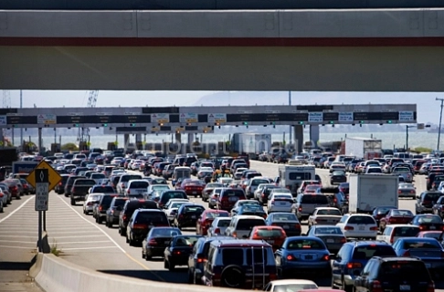

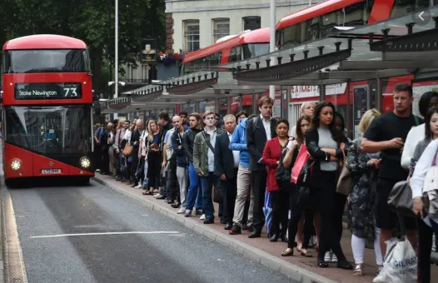
Packet-switching: queueing
R = 100 Mb/s
C
A
R = 1.5 Mb/s
D
B
E
queue of packets
waiting for transmission over output link
Queueing occurs when work arrives faster than it can be serviced:

Slide 32
Packet-switching: queueing
R = 100 Mb/s
C
A
R = 1.5 Mb/s
D
B
E
queue of packets
waiting for transmission over output link
Packet queuing and loss: if arrival rate (in bps) to link exceeds transmission rate (bps) of link for some period of time:
packets will queue, waiting to be transmitted on output link
packets can be dropped (lost) if memory (buffer) in router fills up

Slide 33
Alternative to packet switching: circuit switching
end-end resources allocated to, reserved for “call” between source and destination
in diagram, each link has four circuits.
call gets 2nd circuit in top link and 1st circuit in right link.
dedicated resources: no sharing
circuit-like (guaranteed) performance
circuit segment idle if not used by call (no sharing)
commonly used in traditional telephone networks
* Check out the online interactive exercises for more examples: http://gaia.cs.umass.edu/kurose_ross/interactive

Slide 34
Circuit switching: FDM and TDM
Frequency Division Multiplexing (FDM)
optical, electromagnetic frequencies divided into (narrow) frequency bands
4 users
frequency
each call allocated its own band, can transmit at max rate of that narrow band
time
Time Division Multiplexing (TDM)
time divided into slots
frequency
each call allocated periodic slot(s), can transmit at maximum rate of (wider) frequency band (only) during its time slot(s)
time

Slide 35
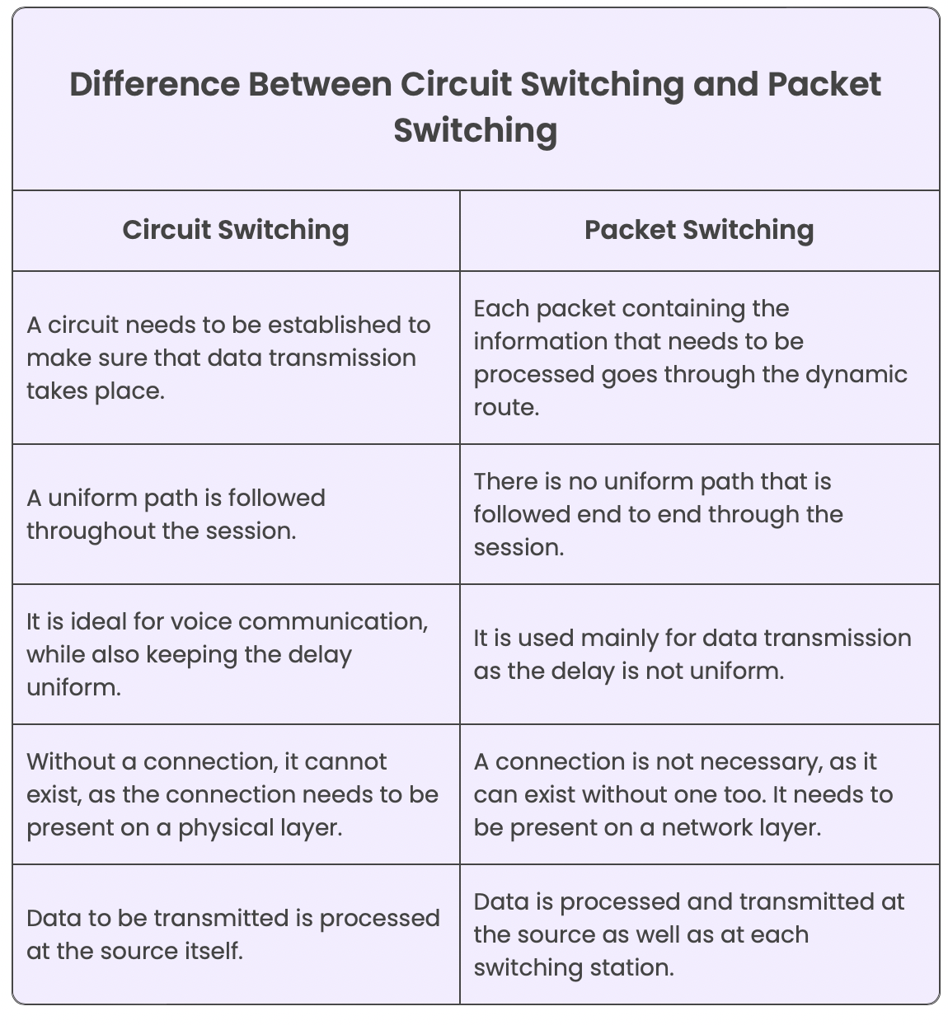
Packet switching versus circuit switching
Notes:
Packet switching is not suitable for real-time services (for example, telephone calls and video conference calls) because of its variable and unpredictable end-to-end delays.
Circuit-switched TDM, if a one-second frame is divided into 10 time slots of 100 ms each, then each user would be allocated one time slot per frame.

Slide 36
Packet switching versus circuit switching
example:
1 Gb/s link
each user:
100 Mb/s when “active”
active 10% of time
…..
N
users
1 Gbps link
Q: how many users can use this network under circuit-switching and packet switching?
circuit-switching: 10 users
packet switching: with 35 users, probability > 10 active at same time is less than .0004 *
Q: how did we get value 0.0004?
A: HW problem (for those with course in probability only)
* Check out the online interactive exercises for more examples: http://gaia.cs.umass.edu/kurose_ross/interactive

Slide 37
Packet switching versus circuit switching
Is packet switching a “slam dunk winner”?
great for “bursty” data – sometimes has data to send, but at other times not
resource sharing
simpler, no call setup
excessive congestion possible: packet delay and loss due to buffer overflow
protocols needed for reliable data transfer, congestion control
Q: How to provide circuit-like behavior with packet-switching?
“It’s complicated.” We’ll study various techniques that try to make packet switching as “circuit-like” as possible.
Q: human analogies of reserved resources (circuit switching) versus on-demand allocation (packet switching)?
Notes:
Virtual Circuits:
Resource Reservation:
Quality of Service (QoS) Implementation:
Traffic Engineering:
Fixed Routing:
Connection-Oriented Protocols:

Slide 38
Internet structure: a “network of networks”
hosts connect to Internet via access Internet Service Providers (ISPs)
access ISPs in turn must be interconnected
so that any two hosts (anywhere!) can send packets to each other
resulting network of networks is very complex
evolution driven by economics, national policies
mobile network
national or global ISP
local or regional ISP
home network
content
provider
network
datacenter
network
enterprise
network
Let’s take a stepwise approach to describe current Internet structure

Slide 39
Internet structure: a “network of networks”
Question: given millions of access ISPs, how to connect them together?
…
…
access
net
access
net
access
net
access
net
access
net
access
net
access
net
…
…
access
net
access
net
access
net
access
net
access
net
access
net
…
access
net
access
net
…
access
net

Slide 40
Internet structure: a “network of networks”
Question: given millions of access ISPs, how to connect them together?
…
…
access
net
access
net
access
net
access
net
access
net
…
…
access
net
access
net
connecting each access ISP to each other directly doesn’t scale: O(N²) connections.
…
…
…
access
net
access
net
…
access
net
access
net
access
net
…
access
net
…
access
net
access
net
…
access
net

Slide 41
Internet structure: a “network of networks”
Option: connect each access ISP to one global transit ISP?
Customer and provider ISPs have economic agreement.
…
…
access
net
access
net
access
net
access
net
access
net
access
net
access
net
…
…
global ISP
access
net
access
net
access
net
access
net
access
net
access
net
…
access
net
access
net
…
access
net

Slide 42
Internet structure: a “network of networks”
But if one global ISP is viable business, there will be competitors ….
…
…
access
net
access
net
access
net
access
net
access
net
access
net
ISP A
access
net
…
…
access
net
ISP B
access
net
ISP C
access
net
access
net
access
net
access
net
…
access
net
access
net
…
access
net

Slide 43
Internet structure: a “network of networks”
But if one global ISP is viable business, there will be competitors …. who will want to be connected
Internet exchange point
…
…
access
net
access
net
access
net
access
net
access
net
IXP
access
net
access
net
ISP A
…
…
access
net
IXP
ISP B
access
net
ISP C
access
net
access
net
peering link
access
net
access
net
…
access
net
access
net
…
access
net

Slide 44
Internet structure: a “network of networks”
… and regional networks may arise to connect access nets to ISPs
…
…
access
net
access
net
access
net
access
net
access
net
IXP
access
net
access
net
ISP A
…
…
access
net
IXP
ISP B
access
net
ISP C
access
net
access
net
access
net
regional ISP
access
net
…
access
net
access
net
…
access
net

Slide 45
Internet structure: a “network of networks”
… and content provider networks (e.g., Google, Microsoft, Akamai) may run their own network, to bring services, content close to end users
…
…
access
net
access
net
access
net
access
net
access
net
IXP
access
net
access
net
ISP A
…
…
Content provider network
access
net
IXP
ISP B
access
net
ISP C
access
net
access
net
access
net
regional ISP
access
net
…
access
net
access
net
…
access
net

Slide 46
Internet structure: a “network of networks”
Tier 1 ISP
Tier 1 ISP
Google
IXP
IXP
IXP
Regional ISP
Regional ISP
access
ISP
access
ISP
access
ISP
access
ISP
access
ISP
access
ISP
access
ISP
access
ISP
At “center”: small # of well-connected large networks
“tier-1” commercial ISPs (e.g., Level 3, Sprint, AT&T, NTT), national & international coverage
content provider networks (e.g., Google, Facebook): private network that connects its data centers to Internet, often bypassing tier-1, regional ISPs

Slide 47
Chapter 1: roadmap
What is the Internet?
What is a protocol?
Network edge: hosts, access network, physical media
Network core: packet/circuit switching, internet structure
Performance: loss, delay, throughput
Security
Protocol layers, service models
History

Slide 48
How do packet delay and loss occur?
packets queue in router buffers, waiting for turn for transmission
queue length grows when arrival rate to link (temporarily) exceeds output link capacity
packet loss occurs when memory to hold queued packets fills up
packet being transmitted (transmission delay)
A
B
packets in buffers (queueing delay)
free (available) buffers: arriving packets
dropped (loss) if no free buffers

Slide 49
Packet delay: four sources
transmission
A
propagation
B
nodal
processing
queueing
d_{nodal} = d_{proc} + d_{queue} + d_{trans} + d_{prop}
d_{proc}: nodal processing
check bit errors
determine output link
typically < microsecs
d_{queue}: queueing delay
time waiting at output link for transmission
depends on congestion level of router

Slide 50
Packet delay: four sources
transmission
A
propagation
B
nodal
processing
queueing
d_{nodal} = d_{proc} + d_{queue} + d_{trans} + d_{prop}
d_{trans}: transmission delay:
L: packet length (bits)
R: link transmission rate (bps)
d_{trans} = L/R
d_{prop}: propagation delay:
d: length of physical link
s: propagation speed (~2x10⁸ m/sec)
d_{prop} = d/s
d_{trans} and d_{prop}
very different

Slide 51

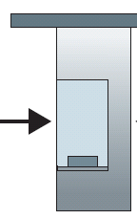
Caravan analogy
100 km
100 km
ten-car caravan
(aka 10-bit packet)
toll booth
toll booth
toll booth
(aka link)
toll booth
toll booth
(aka link)
car ~ bit; caravan ~ packet; toll service ~ link transmission
toll booth takes 12 sec to service car (bit transmission time)
“propagate” at 100 km/hr
Q: How long until caravan is lined up before 2nd toll booth?
time to “push” entire caravan through toll booth onto highway = 12*10 = 120 sec
time for last car to propagate from 1st to 2nd toll both: 100km/(100km/hr) = 1 hr
A: 62 minutes

Slide 52

Caravan analogy
100 km
100 km
ten-car caravan
(aka 10-bit packet)
toll booth
(aka router)
toll booth
suppose cars now “propagate” at 1000 km/hr
and suppose toll booth now takes one min to service a car
Q: Will cars arrive to 2nd booth before all cars serviced at first booth?
A: Yes! after 7 min, first car arrives at second booth; three cars still at first booth

Slide 53

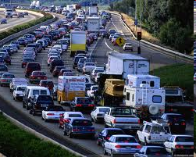
Packet queueing delay (revisited)
a: average packet arrival rate
L: packet length (bits)
R: link bandwidth (bit transmission rate)
average queueing delay
L
a
.
:
arrival rate of bits
“traffic
intensity”
R
service rate of bits
traffic intensity = La/R
1
La/R ~ 0: avg. queueing delay small
La/R -> 1: avg. queueing delay large
La/R > 1: more “work” arriving is more than can be serviced - average delay infinite!
La/R ~ 0
La/R -> 1

Slide 54
“Real” Internet delays and routes
what do “real” Internet delay & loss look like?
traceroute program: provides delay measurement from source to router along end-end Internet path towards destination. For all i:
sends three packets that will reach router i on path towards destination (with time-to-live field value of i)
router i will return packets to sender
sender measures time interval between transmission and reply
3 probes
3 probes
3 probes

Slide 55
Real Internet delays and routes
traceroute: gaia.cs.umass.edu to www.eurecom.fr
3 delay measurements from
gaia.cs.umass.edu to cs-gw.cs.umass.edu
1 cs-gw (128.119.240.254) 1 ms 1 ms 2 ms
2 border1-rt-fa5-1-0.gw.umass.edu (128.119.3.145) 1 ms 1 ms 2 ms
3 cht-vbns.gw.umass.edu (128.119.3.130) 6 ms 5 ms 5 ms
4 jn1-at1-0-0-19.wor.vbns.net (204.147.132.129) 16 ms 11 ms 13 ms
5 jn1-so7-0-0-0.wae.vbns.net (204.147.136.136) 21 ms 18 ms 18 ms
6 abilene-vbns.abilene.ucaid.edu (198.32.11.9) 22 ms 18 ms 22 ms
7 nycm-wash.abilene.ucaid.edu (198.32.8.46) 22 ms 22 ms 22 ms
8 62.40.103.253 (62.40.103.253) 104 ms 109 ms 106 ms
9 de2-1.de1.de.geant.net (62.40.96.129) 109 ms 102 ms 104 ms
10 de.fr1.fr.geant.net (62.40.96.50) 113 ms 121 ms 114 ms
11 renater-gw.fr1.fr.geant.net (62.40.103.54) 112 ms 114 ms 112 ms
12 nio-n2.cssi.renater.fr (193.51.206.13) 111 ms 114 ms 116 ms
13 nice.cssi.renater.fr (195.220.98.102) 123 ms 125 ms 124 ms
14 r3t2-nice.cssi.renater.fr (195.220.98.110) 126 ms 126 ms 124 ms
15 eurecom-valbonne.r3t2.ft.net (193.48.50.54) 135 ms 128 ms 133 ms
16 194.214.211.25 (194.214.211.25) 126 ms 128 ms 126 ms
17 * * *
18 * * *
19 fantasia.eurecom.fr (193.55.113.142) 132 ms 128 ms 136 ms
3 delay measurements
to border1-rt-fa5-1-0.gw.umass.edu
trans-oceanic link
looks like delays decrease! Why?
* means no response (probe lost, router not replying)
* Do some traceroutes from exotic countries at www.traceroute.org

Slide 56
Packet loss
queue (aka buffer) preceding link in buffer has finite capacity
packet arriving to full queue dropped (aka lost)
lost packet may be retransmitted by previous node, by source end system, or not at all
buffer
(waiting area)
A
packet being transmitted
B
packet arriving to
full buffer is lost
* Check out the Java applet for an interactive animation (on publisher’s website) of queuing and loss

Slide 57
Throughput
throughput: rate (bits/time unit) at which bits are being sent from sender to receiver
instantaneous: rate at given point in time
average: rate over longer period of time
link capacity
R_{s} bits/sec
link capacity
R_{c} bits/sec
pipe that can carry
fluid at rate
(R_{s} bits/sec)
pipe that can carry
fluid at rate
(R_{c} bits/sec)
server sends bits
(fluid) into pipe
server, with
file of F bits
to send to client

Slide 58
Throughput
R_{s} < R_{c} What is average end-end throughput?
R_{s} bits/sec
R_{c} bits/sec
R_{s} > R_{c} What is average end-end throughput?
R_{s} bits/sec
R_{c} bits/sec
bottleneck link
link on end-end path that constrains end-end throughput

Slide 59
Throughput: network scenario
per-connection end-end throughput: min(R_{c},R_{s},R/10)
in practice: R_{c} or R_{s} is often bottleneck
R_{s}
R_{s}
R_{s}
R
R_{c}
R_{c}
R_{c}
* Check out the online interactive exercises for more examples: http://gaia.cs.umass.edu/kurose_ross/
10 connections (fairly) share backbone bottleneck link R bits/sec

Slide 60
Chapter 1: roadmap
What is the Internet?
What is a protocol?
Network edge: hosts, access network, physical media
Network core: packet/circuit switching, internet structure
Performance: loss, delay, throughput
Security
Protocol layers, service models
History
Notes:
Segue: from performance to security

Slide 61
Network security
Internet not originally designed with (much) security in mind
original vision: “a group of mutually trusting users attached to a transparent network” ☺
Internet protocol designers playing “catch-up”
security considerations in all layers!
We now need to think about:
how bad guys can attack computer networks
how we can defend networks against attacks
how to design architectures that are immune to attacks

Slide 62
Network security
Internet not originally designed with (much) security in mind
original vision: “a group of mutually trusting users attached to a transparent network” ☺
Internet protocol designers playing “catch-up”
security considerations in all layers!
We now need to think about:
how bad guys can attack computer networks
how we can defend networks against attacks
how to design architectures that are immune to attacks

Slide 63


Bad guys: packet interception
packet “sniffing”:
broadcast media (shared Ethernet, wireless)
promiscuous network interface reads/records all packets (e.g., including passwords!) passing by
A
C
src:B dest:A payload
B
Wireshark software used for our end-of-chapter labs is a (free) packet-sniffer

Slide 64
Bad guys: fake identity
IP spoofing: injection of packet with false source address
A
C
src:B dest:A payload
B

Slide 65
Bad guys: denial of service
Denial of Service (DoS): attackers make resources (server, bandwidth) unavailable to legitimate traffic by overwhelming resource with bogus traffic
1. select target
2. break into hosts around the network (see botnet)
3. send packets to target from compromised hosts
target

Slide 66
Lines of defense:
authentication: proving you are who you say you are
cellular networks provides hardware identity via SIM card; no such hardware assist in traditional Internet
confidentiality: via encryption
integrity checks: digital signatures prevent/detect tampering
access restrictions: password-protected VPNs
firewalls: specialized “middleboxes” in access and core networks:
off-by-default: filter incoming packets to restrict senders, receivers, applications
detecting/reacting to DOS attacks
… lots more on security (throughout, Chapter 8)

Slide 67
Chapter 1: roadmap
What is the Internet?
What is a protocol?
Network edge: hosts, access network, physical media
Network core: packet/circuit switching, internet structure
Performance: loss, delay, throughput
Security
Protocol layers, service models
History

Slide 68
Protocol “layers” and reference models
Networks are complex,
with many “pieces”:
hosts
routers
links of various media
applications
protocols
hardware, software
Question: is there any hope of organizing structure of network?
and/or our discussion of networks?

Slide 69

Example: organization of air travel
end-to-end transfer of person plus baggage
ticket (purchase)
baggage (check)
gates (load)
runway takeoff
airplane routing
ticket (complain)
baggage (claim)
gates (unload)
runway landing
airplane routing
airplane routing
How would you define/discuss the system of airline travel?
a series of steps, involving many services

Slide 70
Example: organization of air travel
ticket (purchase)
baggage (check)
gates (load)
runway takeoff
airplane routing
ticketing service
ticket (complain)
baggage (claim)
gates (unload)
runway landing
airplane routing
baggage service
gate service
runway service
routing service
airplane routing
layers: each layer implements a service
via its own internal-layer actions
relying on services provided by layer below

Slide 71
Why layering?
Approach to designing/discussing complex systems:
explicit structure allows identification, relationship of system’s pieces
layered reference model for discussion
modularization eases maintenance, updating of system
change in layer's service implementation: transparent to rest of system
e.g., change in gate procedure doesn’t affect rest of system

Slide 72
Layered Internet protocol stack
application: supporting network applications
HTTP, IMAP, SMTP, DNS
transport: process-process data transfer
TCP, UDP
network: routing of datagrams from source to destination
IP, routing protocols
link: data transfer between neighboring network elements
Ethernet, 802.11 (WiFi), PPP
physical: bits “on the wire”
application
application
transport
transport
network
network
link
link
physical
physical

Slide 73
Services, Layering and Encapsulation
application
transport
network
link
physical
M
application
transport
network
link
physical
Application exchanges messages to implement some application service using services of transport layer
H_{t}
M
Transport-layer protocol transfers M (e.g., reliably) from one process to another, using services of network layer
transport-layer protocol encapsulates application-layer message, M, with transport layer-layer header H_{t} to create a transport-layer segment
H_{t} used by transport layer protocol to implement its service
source
destination

Slide 74
Services, Layering and Encapsulation
application
transport
network
link
physical
M
application
transport
network
link
physical
H_{t}
M
Transport-layer protocol transfers M (e.g., reliably) from one process to another, using services of network layer
H_{n}
H_{t}
M
Network-layer protocol transfers transport-layer segment [H_{t} | M] from one host to another, using link layer services
network-layer protocol encapsulates transport-layer segment [H_{t} | M] with network layer-layer header H_{n} to create a network-layer datagram
H_{n} used by network layer protocol to implement its service
source
destination

Slide 75
Services, Layering and Encapsulation
H_{n}
H_{t}
M
application
transport
network
link
physical
M
application
transport
network
link
physical
H_{t}
M
H_{n}
H_{t}
M
Network-layer protocol transfers transport-layer segment [H_{t} | M] from one host to another, using link layer services
H_{l}
H_{n}
H_{t}
M
Link-layer protocol transfers datagram [H_{n}| [H_{t} |M] from host to neighboring host, using network-layer services
link-layer protocol encapsulates network datagram [H_{n}| [H_{t} |M], with link-layer header H_{l} to create a link-layer frame
source
destination

Slide 76





Encapsulation
Matryoshka dolls (stacking dolls)
message
segment
datagram
frame
Credit: https://dribbble.com/shots/7182188-Babushka-Boi
Notes:
Thanks to Nikko Bovornkeeratiroj, Phuthipong <phuthipong@cs.umass.edu>, for the stacking dolls idea and slides

Slide 77
Services, Layering and Encapsulation
application
transport
network
link
physical
application
transport
network
link
physical
message
M
M
segment
H_{t}
M
H_{t}
M
datagram
H_{n}
H_{t}
M
H_{n}
H_{t}
M
frame
H_{l}
H_{n}
H_{t}
M
H_{l}
H_{n}
H_{t}
M
source
destination

Slide 78
Encapsulation: an end-end view
source
message
M
application
transport
network
link
physical
segment
H_{t}
M
H_{t}
datagram
H_{n}
H_{t}
H_{n}
M
frame
H_{l}
H_{n}
H_{t}
M
link
physical
switch
destination
H_{n}
H_{t}
M
network
link
physical
M
application
transport
network
link
physical
H_{l}
H_{n}
H_{t}
M
H_{n}
H_{t}
M
H_{t}
M
H_{n}
H_{t}
M
H_{l}
H_{n}
H_{t}
M
router

Slide 79
Chapter 1: roadmap
What is the Internet?
What is a protocol?
Network edge: hosts, access network, physical media
Network core: packet/circuit switching, internet structure
Performance: loss, delay, throughput
Security
Protocol layers, service models
History

Slide 80
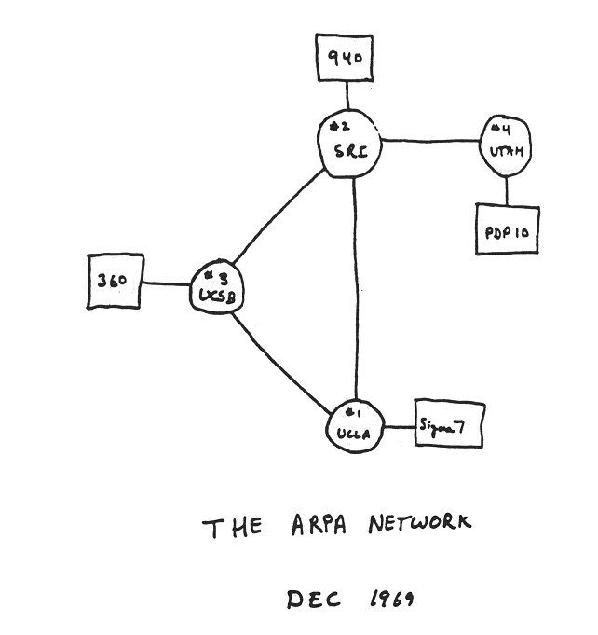
Internet history
1961-1972: Early packet-switching principles
1961: Kleinrock - queueing theory shows effectiveness of packet-switching
1964: Baran - packet-switching in military nets
1967: ARPAnet conceived by Advanced Research Projects Agency
1969: first ARPAnet node operational
1972:
ARPAnet public demo
NCP (Network Control Protocol) first host-host protocol
first e-mail program
ARPAnet has 15 nodes

Slide 81
Internet history
1972-1980: Internetworking, new and proprietary networks
1970: ALOHAnet satellite network in Hawaii
1974: Cerf and Kahn - architecture for interconnecting networks
1976: Ethernet at Xerox PARC
late70’s: proprietary architectures: DECnet, SNA, XNA
1979: ARPAnet has 200 nodes
Cerf and Kahn’s internetworking principles:
minimalism, autonomy - no internal changes required to interconnect networks
best-effort service model
stateless routing
decentralized control
define today’s Internet architecture

Slide 82
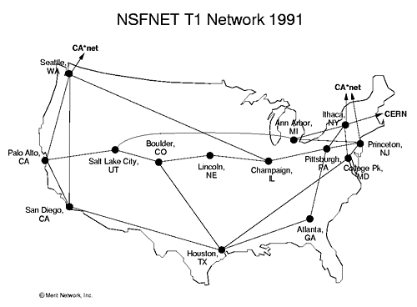
Internet history
1980-1990: new protocols, a proliferation of networks
1983: deployment of TCP/IP
1982: smtp e-mail protocol defined
1983: DNS defined for name-to-IP-address translation
1985: ftp protocol defined
1988: TCP congestion control
new national networks: CSnet, BITnet, NSFnet, Minitel
100,000 hosts connected to confederation of networks

Slide 83
Internet history
1990, 2000s: commercialization, the Web, new applications
early 1990s: ARPAnet decommissioned
1991: NSF lifts restrictions on commercial use of NSFnet (decommissioned, 1995)
early 1990s: Web
hypertext [Bush 1945, Nelson 1960’s]
HTML, HTTP: Berners-Lee
1994: Mosaic, later Netscape
late 1990s: commercialization of the Web
late 1990s – 2000s:
more killer apps: instant messaging, P2P file sharing
network security to forefront
est. 50 million host, 100 million+ users
backbone links running at Gbps

Slide 84
Internet history
2005-present: scale, SDN, mobility, cloud
aggressive deployment of broadband home access (10-100’s Mbps)
2008: software-defined networking (SDN)
increasing ubiquity of high-speed wireless access: 4G/5G, WiFi
service providers (Google, FB, Microsoft) create their own networks
bypass commercial Internet to connect “close” to end user, providing “instantaneous” access to social media, search, video content, …
enterprises run their services in “cloud” (e.g., Amazon Web Services, Microsoft Azure)
rise of smartphones: more mobile than fixed devices on Internet (2017)
~15B devices attached to Internet (2023, statista.com)

Slide 85
Chapter 1: summary
We’ve covered a “ton” of material!
Internet overview
what’s a protocol?
network edge, access network, core
packet-switching versus circuit-switching
Internet structure
performance: loss, delay, throughput
layering, service models
security
history
You now have:
context, overview, vocabulary, “feel” of networking
more depth, detail, and fun to follow!

Slide 86
Additional Chapter 1 slides

Slide 87
ISO/OSI reference model
Two layers not found in Internet protocol stack!
presentation: allow applications to interpret meaning of data, e.g., encryption, compression, machine-specific conventions
session: synchronization, checkpointing, recovery of data exchange
Internet stack “missing” these layers!
these services, if needed, must be implemented in application
needed?
application
presentation
session
transport
network
link
physical
The seven layer OSI/ISO
reference model

Slide 88
Services, Layering and Encapsulation
application
transport
network
link
physical
M
application
transport
network
link
physical
M
message
H_{t}
M
H_{t}
M
segment
H_{n}
H_{t}
M
H_{n}
H_{t}
M
datagram
H_{l}
H_{n}
H_{t}
M
H_{l}
H_{n}
H_{t}
M
frame
source
destination

Slide 89

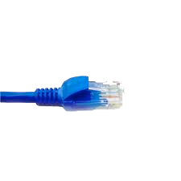
Wireshark
application
(www browser,
email client)
packet
analyzer
application
OS
packet
capture
(pcap)
Transport (TCP/UDP)
Network (IP)
Link (Ethernet)
Physical
copy of all Ethernet frames sent/received

